Slide 1

Modelling phase transitions: Characterising Henry's Law
Joshua Cheung
Supervised by Jo Grundy and Jeremy Frey
https://www.psdi.ac.uk/

Slide 2
Colours and Fonts (remove from final presentation)
Headings: Open Sans Condensed
Body Text: Lato
Colours: if these colour boxes match up the document has applied the colour theme.
Additional Colour:
#011e41
#002169
#3d7cc9
#ff9e18
#5aa2ae
#bbbbbb
#e5e1e6
#9d90a0
#993366

Slide 3

About me
2nd Year Chemistry with Digital Methods and Computational Modelling
I still don’t have a photo of myself, so here’s another cat photo I took
Continuation of my project from last summer with PSDI: Modelling Miscibility with Machine Learning
I enjoy reading sci fi, gaming, and playing guitar

Slide 4
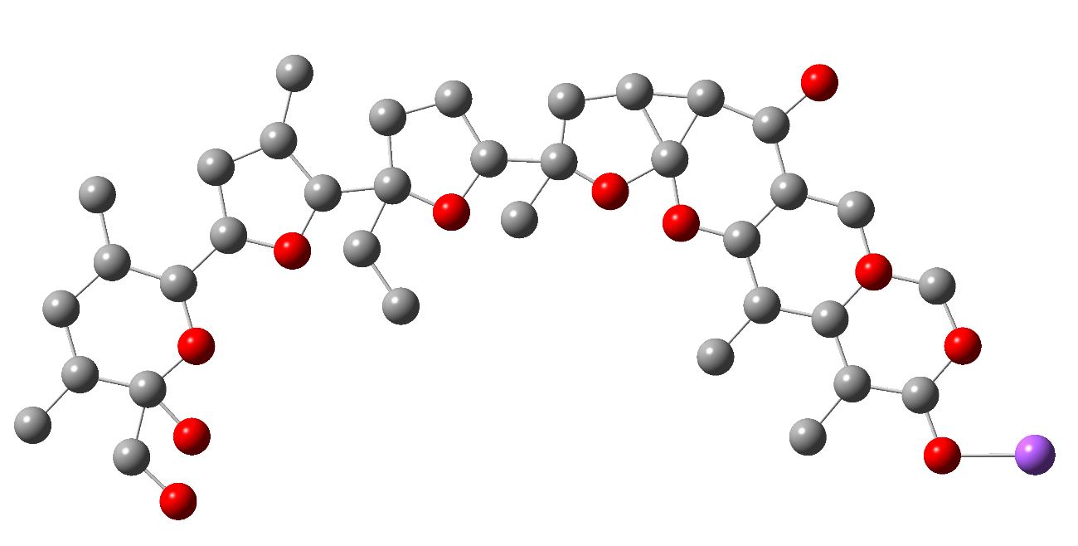
Presentation Outline
Project Description
Background
Methodology
Dataset Building
Data Processing
Machine Learning
Results
Challenges
Conclusions and Future Work
Monensin, an antibiotic, one of the compounds in the dataset

Slide 5
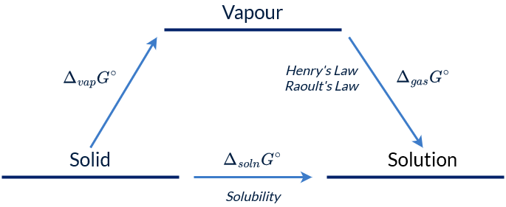
Project Description
Exploring the links between Henry’s Law constant (k_{H}) and Solubility (logS)
Important for pharmaceuticals, synthesis in industry, electrochemistry, etc.
Possible to calculate experimentally, but time consuming and difficult
Extremely computationally expensive to model using quantum mechanical simulations
Solution: Machine Learning
Change since interim presentation:
No more CMC. Removed because there was insufficient data.

Slide 6
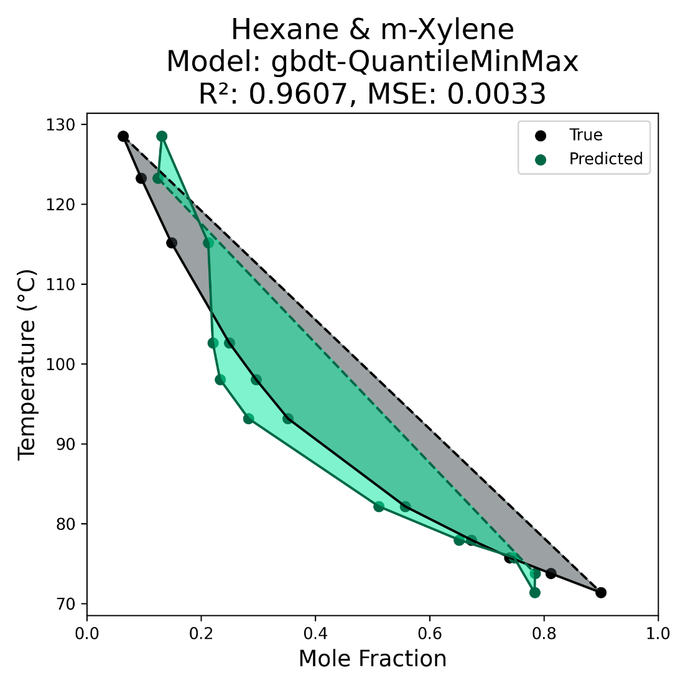
Why Predict Henry’s Law Constant?
Highly important properties with a wide range of applications in research and synthesis
Existing data is limited and derived indirectly via experiment using an equation
Existing models and papers use semi-empirical methods -> lack of experimentation with machine learning
Can be calculated if there is phase-equilibria data for the compound pair at a given temperature
Temperature dependent phase-equilibrium diagram predicted using machine learning (2023)

Slide 7
What actually is machine learning?
The process of computers improving their own ability to carry out tasks by analysing new data, without a human needing to give instructions in the form of a program
– Cambridge Dictionary
Input Data
Create trained model
Use trained model to predict things for new input data
Output
The quality of the output depends on the quality of the input, and the parameters of the mysterious black box.

Slide 8
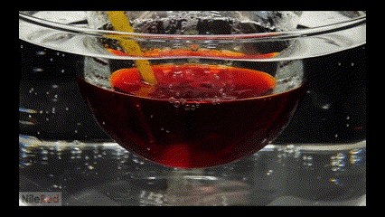
Background
Henry’s Law: The abundance of a volatile solute dissolved in a liquid is proportional to its abundance in the gas phase.
Solubility: The analytical composition of a saturated solution, expressed in terms of the proportion of a designated solute in a designated solvent, is the solubility of that solute.
Or more simply: How much of the substance (liquid or gas) can be dissolved in the solvent?
https://iupac.org/recommendation/henrys-law-constants/
https://goldbook.iupac.org/terms/view/S05740
https://www.youtube.com/watch?v=zMaTrgUKC1w

Slide 9
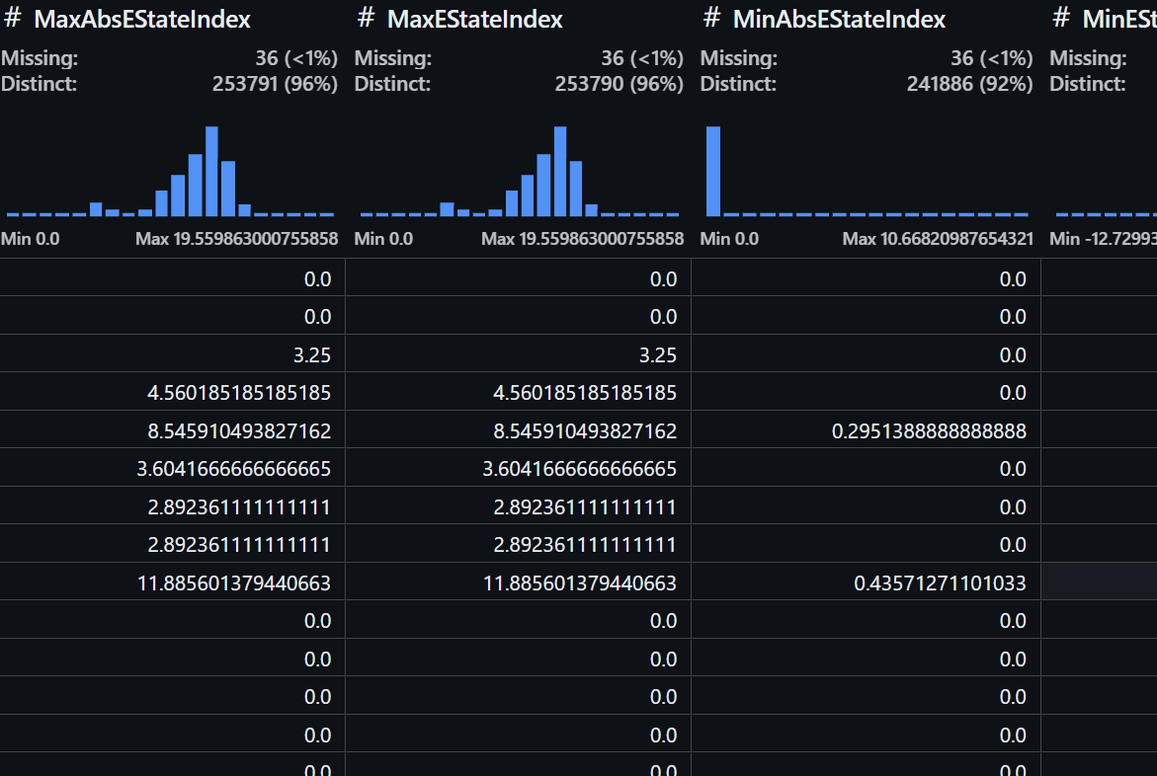
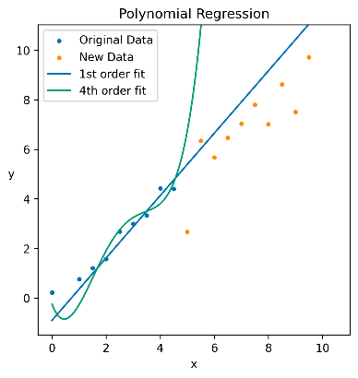
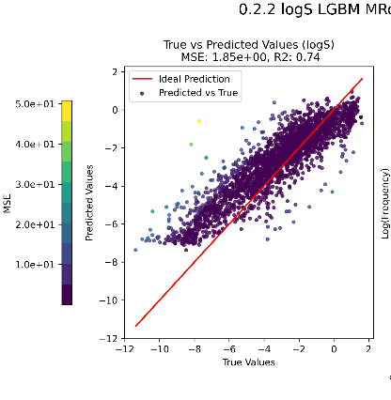
Methodology Overview
Dataset building
Data processing
Machine Learning
Results
RDKit
AqSolDB
Henry’s Law
IUPAC
Notes:
Overall process

Slide 10

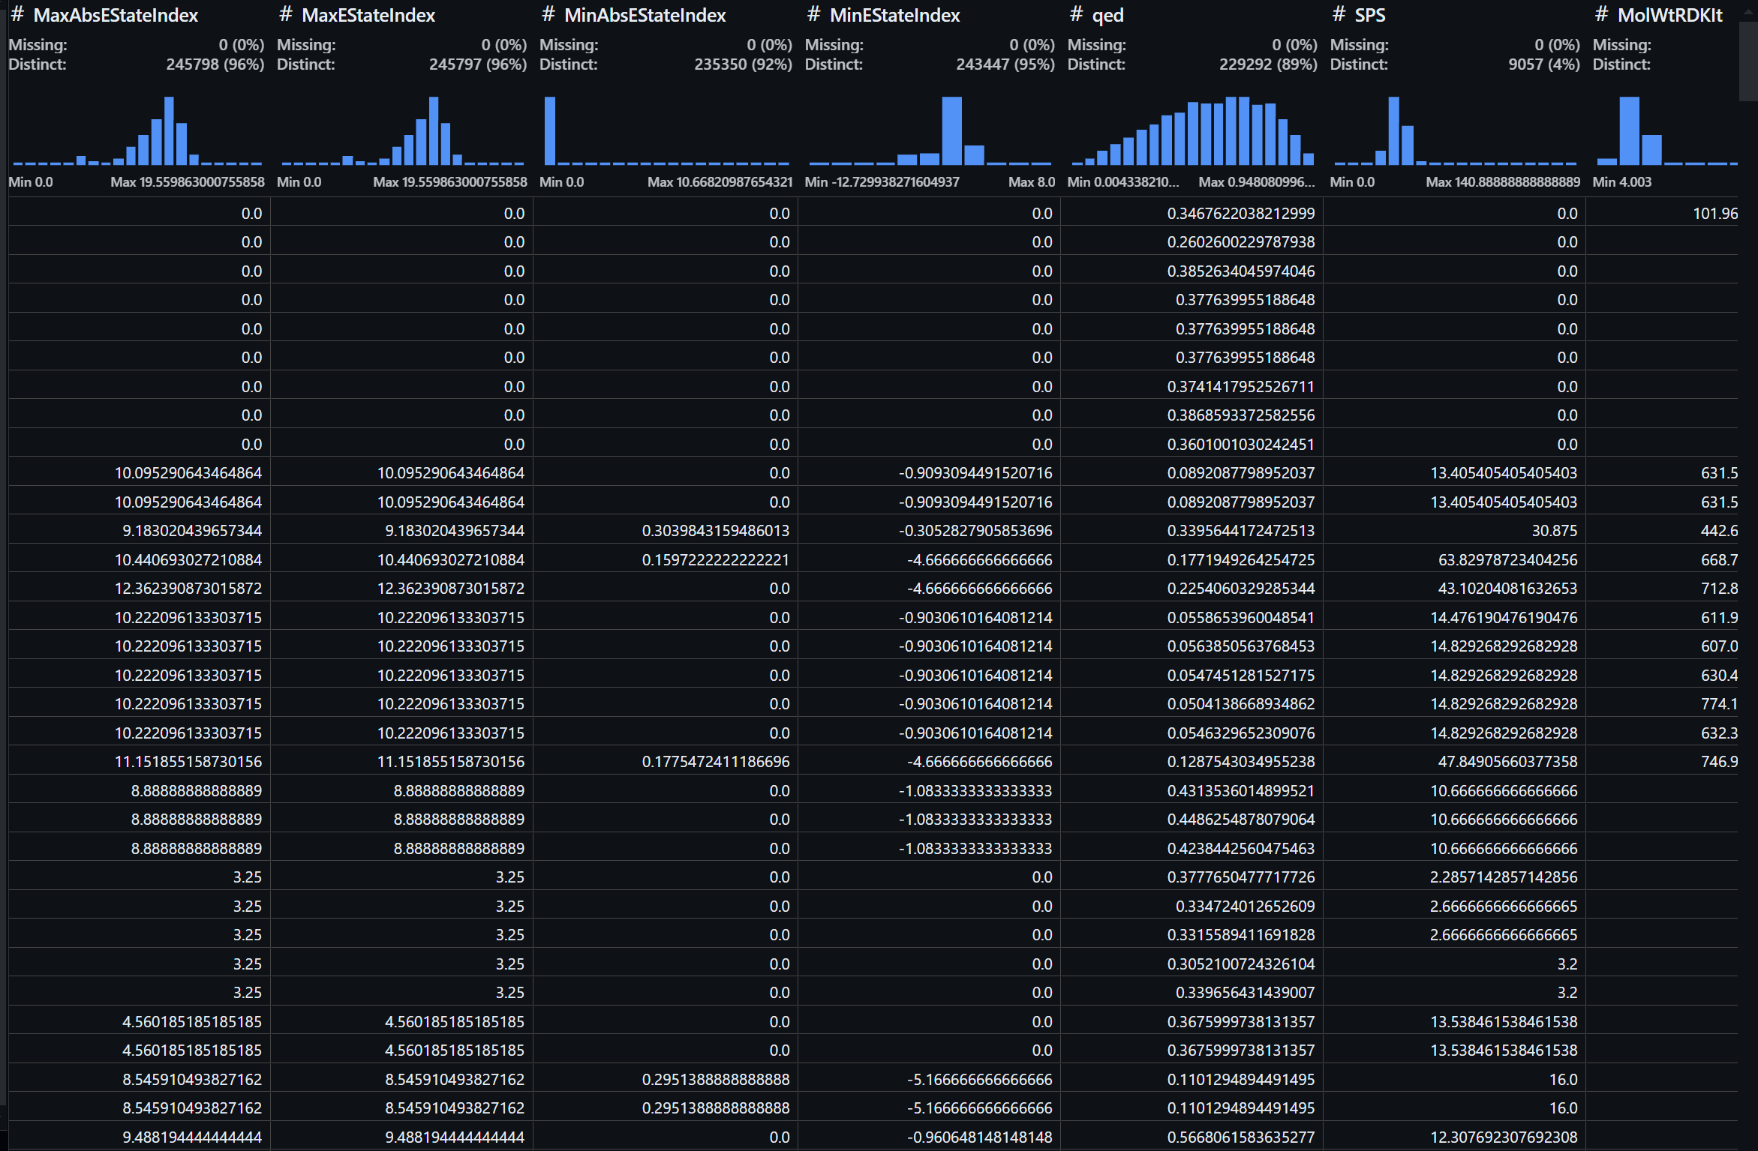


Dataset Building

Slide 11
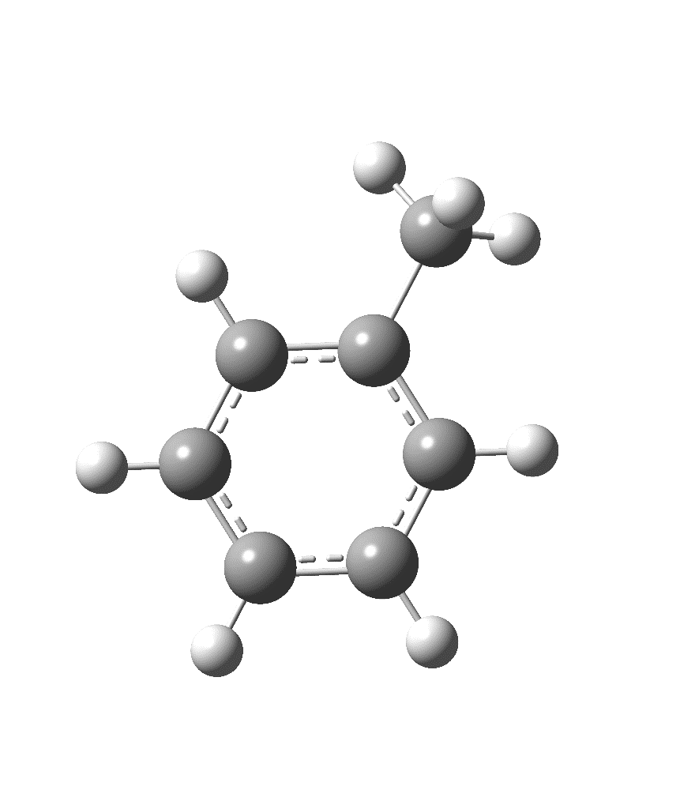
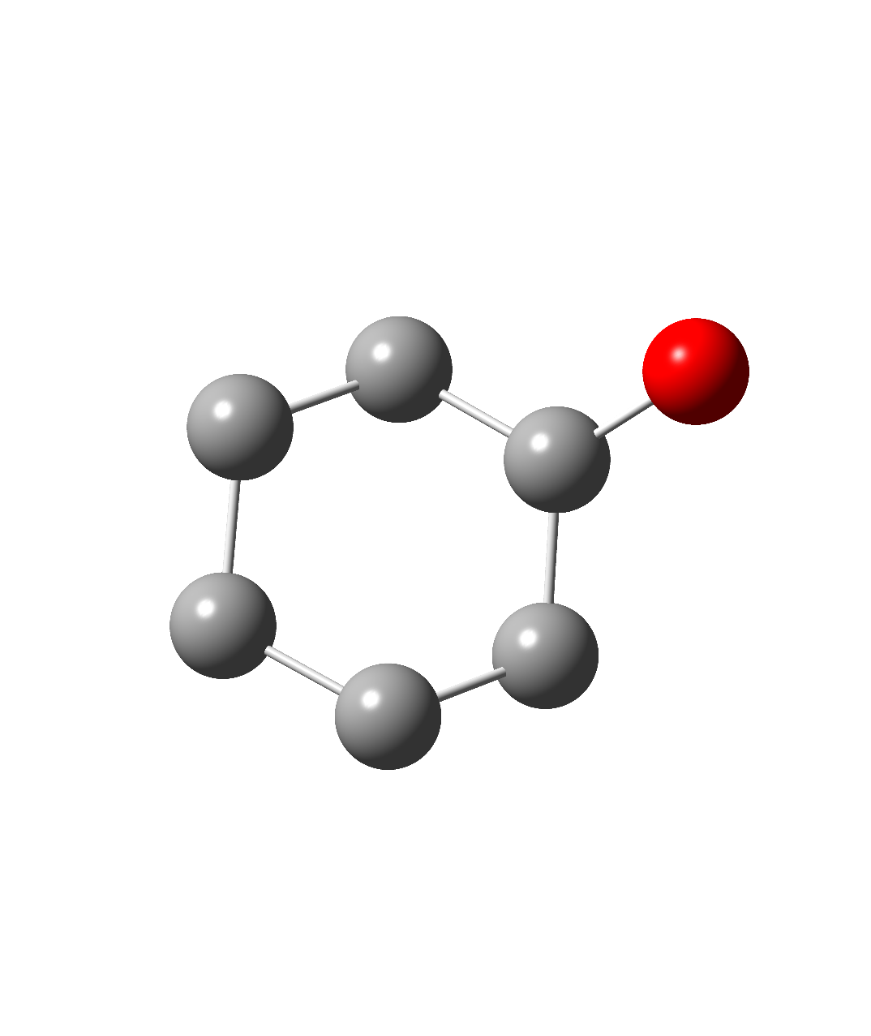
Dataset Building
Feature | Entry Count | Unique Compound Count | Most abundant
logS (solubility) | 11 703 | 11 089 | Cyclohexanol (24)
Henry’s law | 12 167 | 9 532 | Toluene (24)
Total Entries | 21 291 | 18 006 | Cyclohexanol (26), Pentan-1-ol

Slide 12
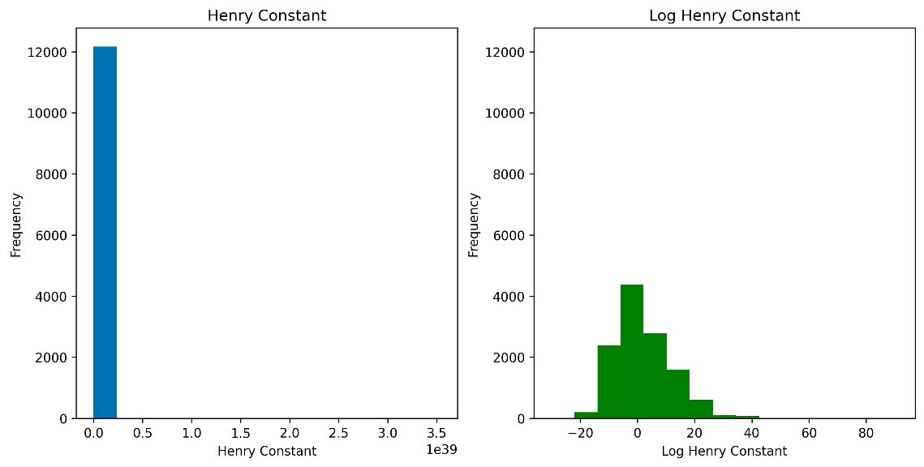
Data Processing
212 features reduced to 78 (removing null values, columns with 0 variance, etc)
Determination of which scaling method works best
Feature selection based on % distinct values in column
For Henry Constant, anything above 10e+15 removed
MinMax -> Robust worked best for log(k_{H}) and log(S)
Normalisation | Scaling Method | MSE | R²
None | None | 5.64 | 0.90
MinMax | RobustScaler() | 6.41 | 0.88
MinMax | StandardScaler() | 6.83 | 0.87
None | Normalize | 7.37 | 0.86
Normalize | MaxAbsScaler() | 7.64 | 0.86
Scores by scaling method for logK_{H}
(Older dataset version than shown in plot)
Notes:
Scaling affects distribution of data, makes it easier for model to effectively differentiate between values
Feature selection tested variety of different ways, eventually just removed anything with <1% distinct values

Slide 13
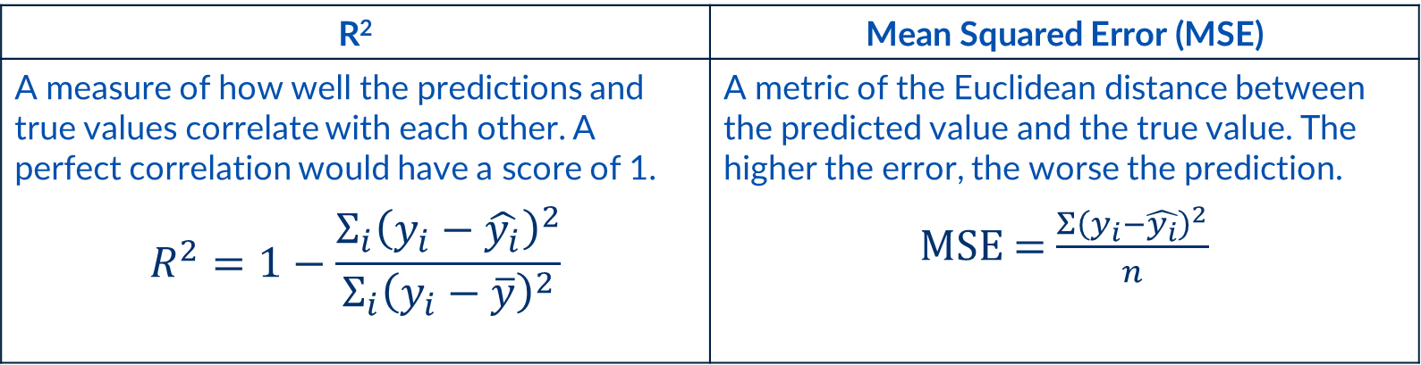
Machine Learning and Results
2 types of machine learning models: Regression and Classification
Prediction of continuous values -> not a classification problem
No way of predicting which algorithm will work best, so multiple tested
How to score models and compare them to figure out what works best?
R² | Mean Squared Error (MSE)
A measure of how well the predictions and true values correlate with each other. A perfect correlation would have a score of 1. | A metric of the Euclidean distance between the predicted value and the true value. The higher the error, the worse the prediction.
$$R^{2}=1−\frac{Σ_{i}{\left(y_{i}−\hat{y_{i}}\right)}^{2}}{Σ_{i}{\left(y_{i}−\overline{y}\right)}^{2}}$$ | MSE = $\frac{Σ{\left(y_{i}−\hat{y_{i}}\right)}^{2}}{n}$

Slide 14
Choosing the Algorithms
logS
log(k_{H})
Algorithm | MSE | R²
LightGBM | 1.01 | 0.80
KRR | 1.06 | 0.79
KNN | 1.23 | 0.76
RandomForest | 1.28 | 0.75
AdaBoost | 1.53 | 0.70
SVR | 1.65 | 0.68
Algorithm | MSE | R2
LightGBM | 5.04 | 0.89
KRR | 5.92 | 0.87
RandomForest | 8.74 | 0.81
KNN | 9.31 | 0.81
AdaBoost | 12.76 | 0.73
SVR | 68.92 | -0.45
Due to evolving datasets, these results are not for the version of the dataset that was used for the final results.

Slide 15
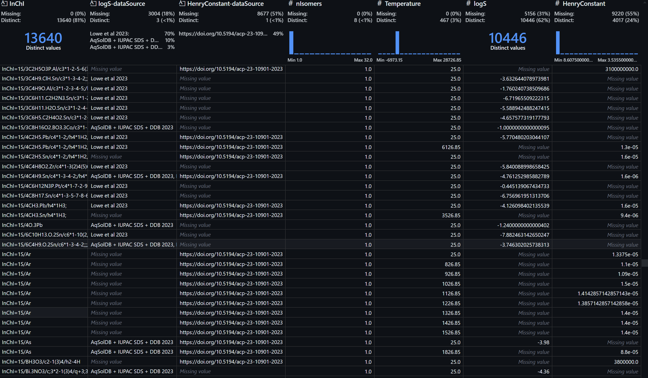
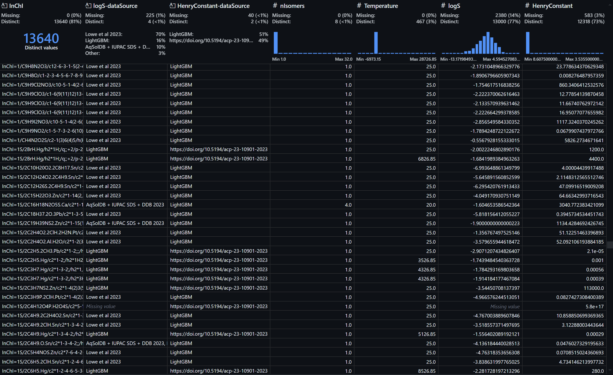
Results and Analysis
Trained model to predict logS using data that has no k_{H} value
Used model to predict logS and fill in dataset gaps
Withheld test set of data that contains logS and Henry’s constant value

Slide 16

Test Set: logS
And repeated for log(k_{H})…

Slide 17
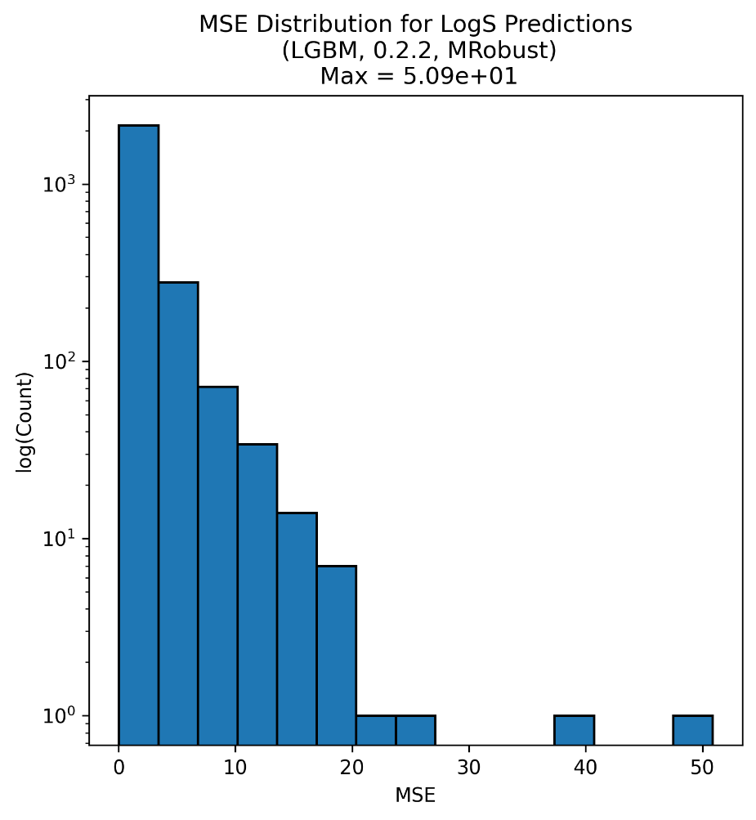
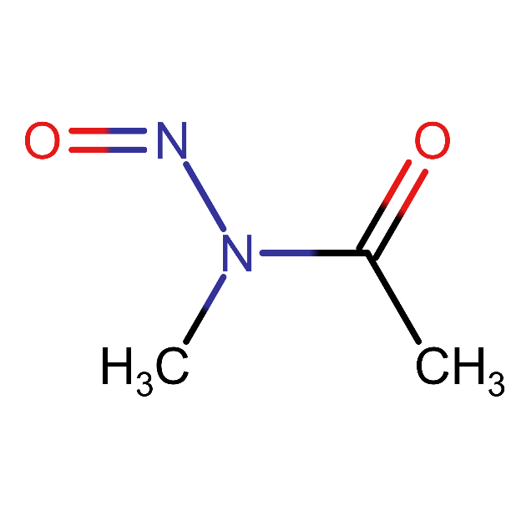
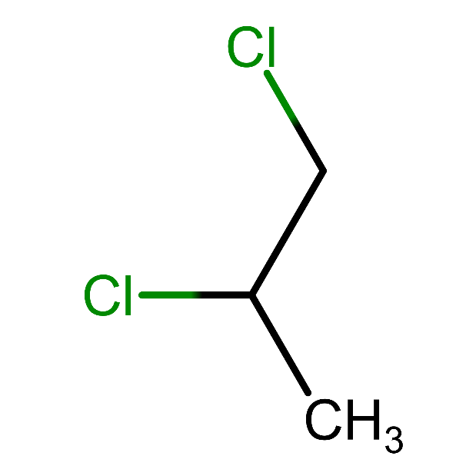
Test Set Metrics: logS
Lowest error: 6.00 x 10⁻⁷
Highest error: 50.80
6th highest error in the test set is ammonia, NH₃, with an MSE of 18.51.
Only bottom 5 have MSE > 20
R² | 0.73
MSE | 1.85
% MSE > 1 | 45.52 %

Slide 18
Test Set: log(k_{H})

Slide 19
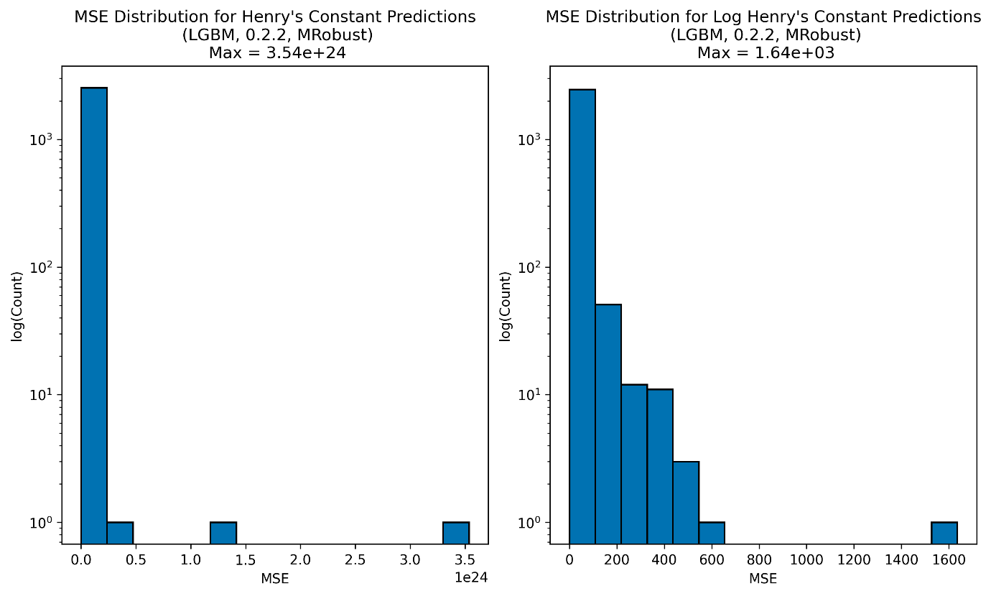
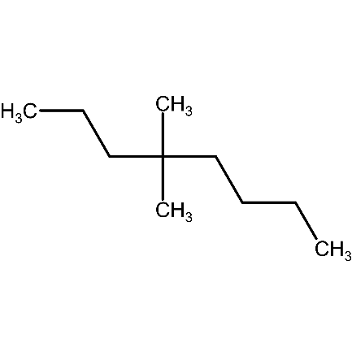
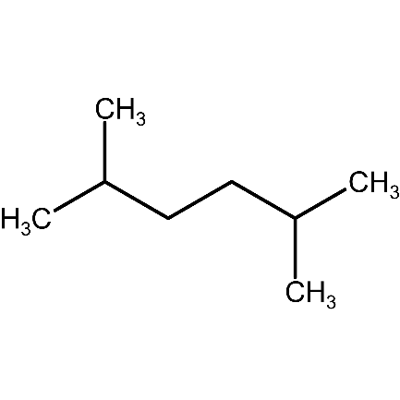
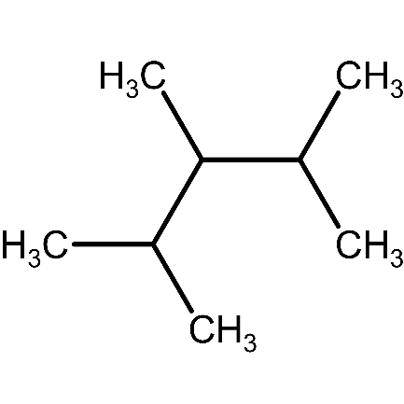
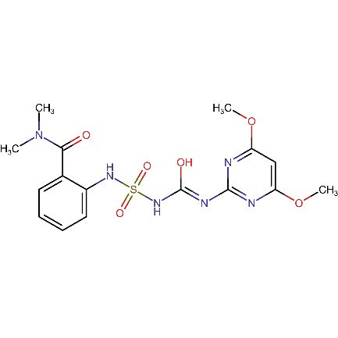
The Antilog: Test Set Metrics
No overlap in 10 worst predictions, but overlap in best 10.
 | Log Scaled | Unscaled
R² | 0.66 | -68.67
MSE | 19.11 | 2.13 x 10²¹
% MSE > 1 | 76.53 % | 52.93 %
Notes:
Highly likely that these results could be improved by rerunning hyperparameter optimisation, etc, as dataset size doubled with bug fix

Slide 20
Choosing the Algorithms
log(k_{H})
Algorithm | MSE | R2
LightGBM | 5.04 | 0.89
KRR | 5.92 | 0.87
RandomForest | 8.74 | 0.81
KNN | 9.31 | 0.81
AdaBoost | 12.76 | 0.73
SVR | 68.92 | -0.45
Henry’s law dataset doubled in size after fixing unresolved identifiers.
Best algorithm, scaling methods, and hyperparameters likely to have changed.
Results from previous slide could almost definitely be improved (time limitations in project)

Slide 21
Challenges
Questionable quality of data, e.g. range of values, number of significant figures, data sources
Lack of temperature data for Henry’s Law constant (all assumed to be at 25c instead)
Identifier conversion (CAS to SMILES, SMILES to InChI) leading to incorrect data in Henry’s Law dataset.
~33 compounds had their SMILES replaced with O, leading to an abundance of chemicals mistakenly being identified as water
Over 2000 had unresolved InChI keys which had to be resolved using alternative methods
My own programming skills. Dataset generation with melting points takes over 24 hours to run, and is probably very poorly optimized.
I could run these programs on Iridis, but errors are likely with file paths and saving.
Runs a lot faster when I stop adding melting point data (~250 000 data points) for no good reason.

Slide 22
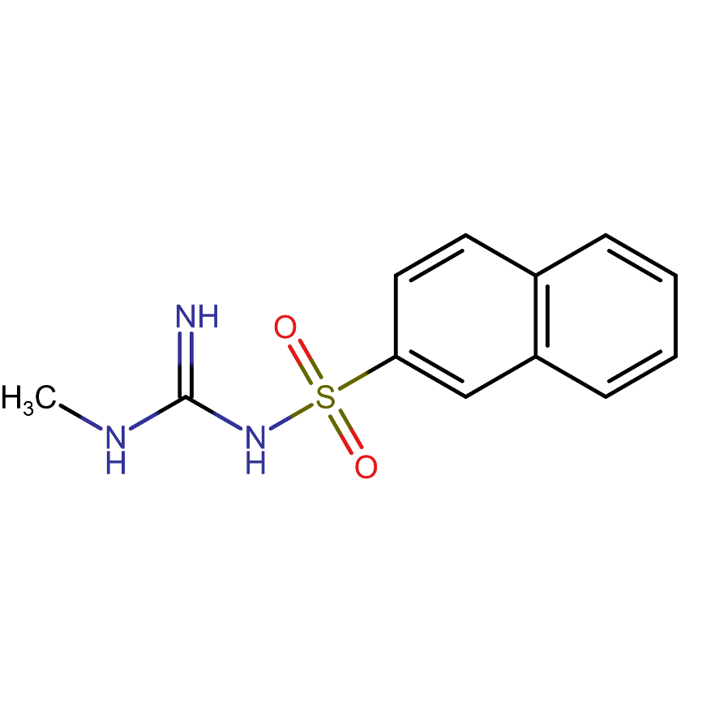
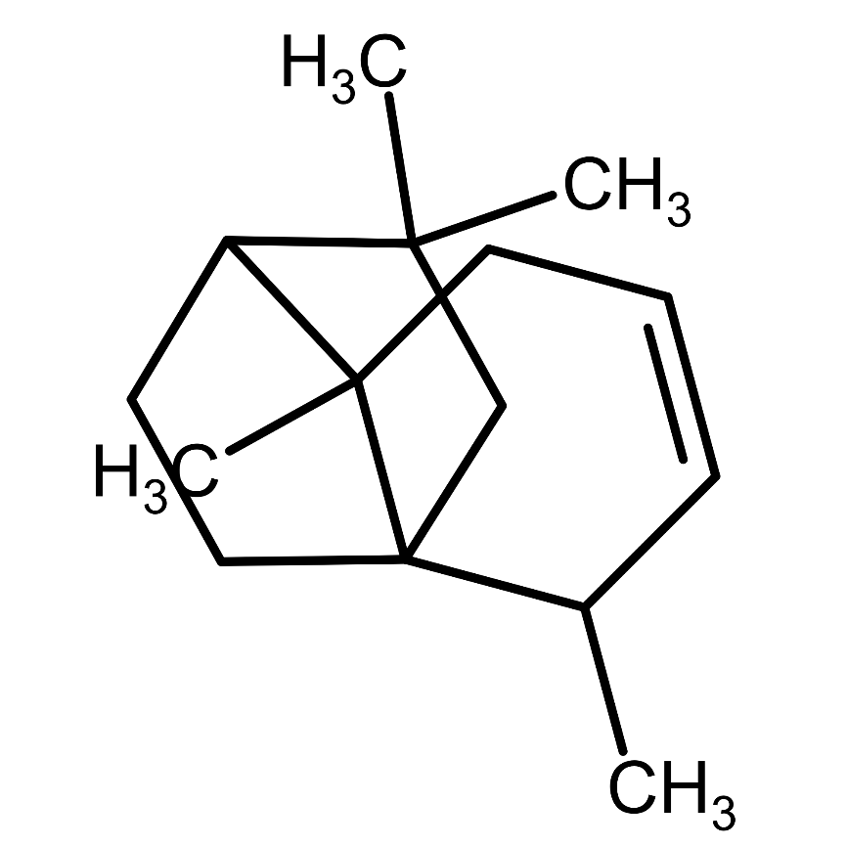
Questionable Identifiers
N-(N-Methylcarbamimidoyl)-2-naphthalenesulfonamide
CNC(=N)NS(=O)(=O)C1=CC2=C(C=CC=C2)C=C1
InChI=1S/Mo
γ-neoclovene
O
InChI=1S/H2O/h1H2
Resolved by using PubChem API instead of NIST, and scraping UoY Master Chemical Mechanism site

Slide 23
What would you do differently?
Better data sanitization to identify compounds which have erroneous values or identifiers
Actually looking at the output of my programs properly instead of just assuming it’s correct because the first 100 worked!
Identify a more solid aim and purpose at the beginning of the project so less time is wasted
Scope was too wide at the beginning of the project, including melting/boiling point, and CMC data.

Slide 24
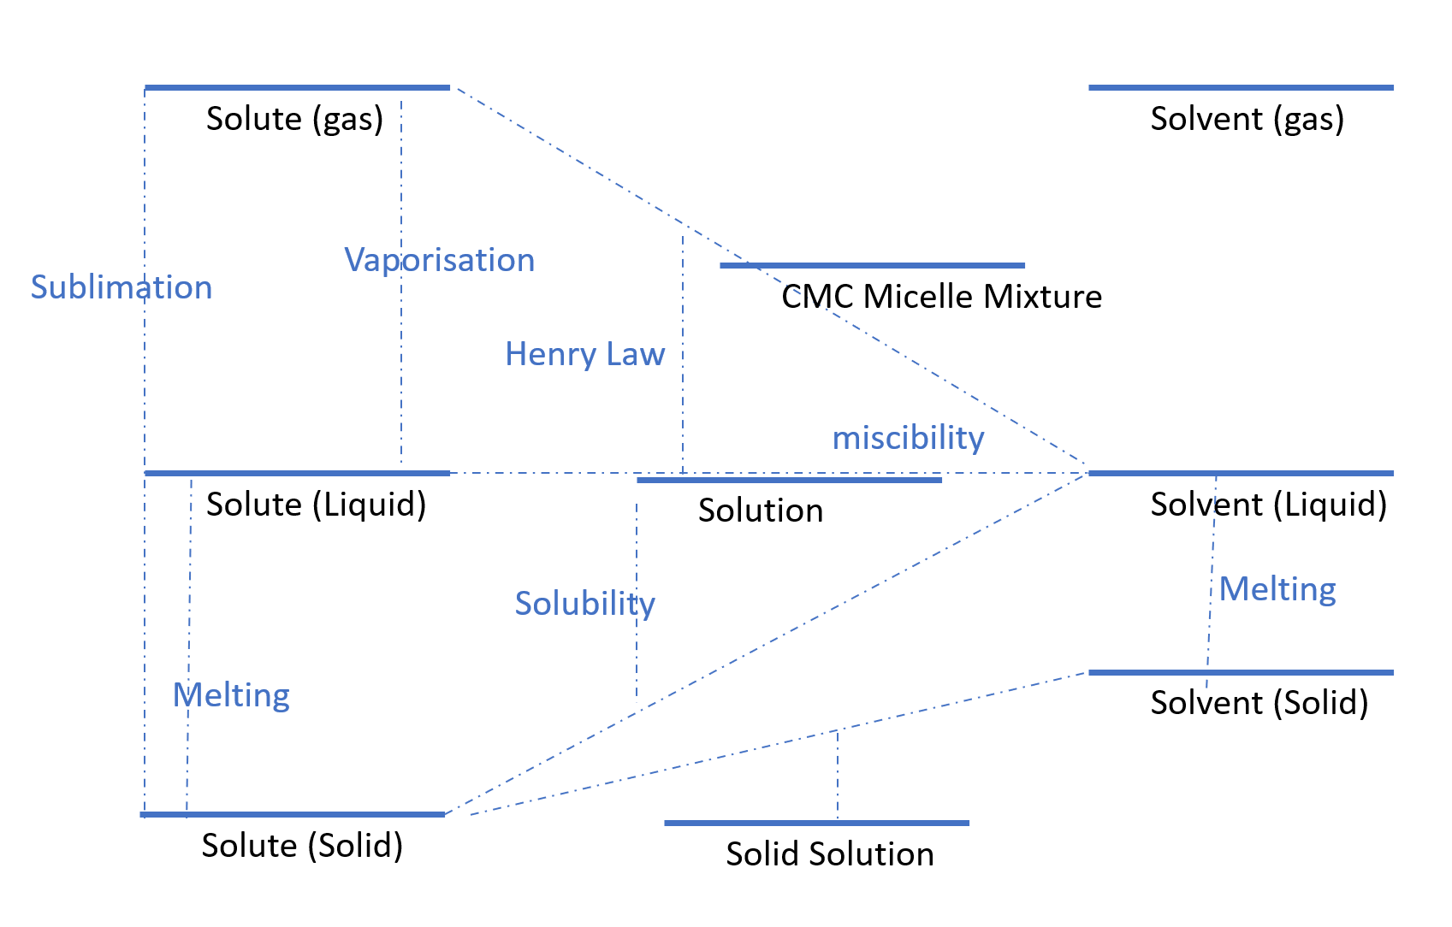
Conclusions and Future Work
It is possible to predict solubility and Henry’s Law constant for an aqueous system
Future Work:
Try using recursive feature elimination to see why no scaling or normalisation had good results
Explore links with melting and boiling points
Look into why the models predicts better for certain types of compound
Diagram by Jeremy Frey

